Slide 1
Understanding Microservices
Venkatt Guhesan
May 2019

Slide 2
Understanding OUR Human journey will help you identify where we are going and hopefully understand the place for microservices IN this journey and the future ahead
Our goal today
- Me ;-)
Putting this differently… I can’t teach you microservices in one hour! But I can take you through a journey that shows you - how we got here, different solutions engineered by others to solve the problem of Microservices, why there is a need for this type of framework, different ways to slice and dice the problem and hopefully you can have enough tools to help you invent your own ** Microservices ** solution!

Slide 3
Microservices – definition (current)
Microservices is a software development technique where the components (or parts of the application) are:
Loosely Coupled
Highly Maintainable
Independently Deployable
Three-Criteria applied:
Yesterday vs. Today vs. Tomorrow
== totally different results
So any application you’re developing that meets the three criteria can be technically called a “microservice”.

Slide 4
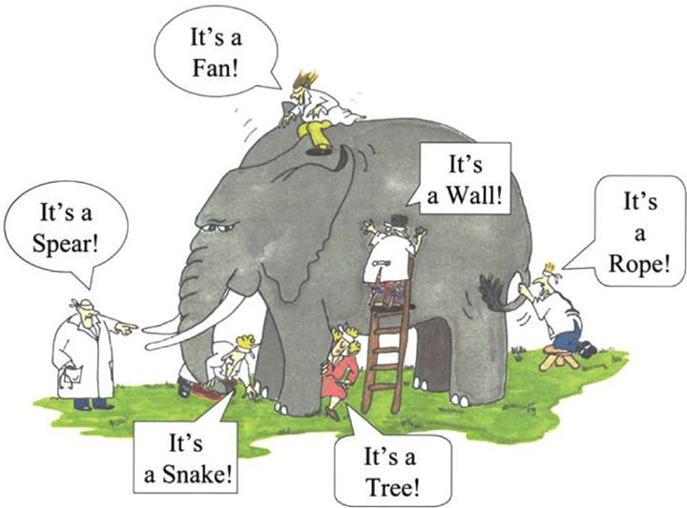
Microservices – REALITY
Let’s take a look at how we got here in the next set of slides … The Journey

Slide 5

Legacy MONOLITHIC Application Structure
Relational Data
Session Management
Shopping Cart Data
WAR
Authentication
Monolithic
Database
Roles & Rights Mgt.
StoreFront
Shopping Cart
Browser
Checkout
dial-up telephony service
External Credit-card Processor
Load-Balancer
+
Apache or Nginx
Credit-card Processor
Service
Order Mgt.
Perl, PHP, Cold Fusion were dominating this scene and Java was making it’s mark!
WAR file deployed in multiple servers to scale horizontally
Tomcat

Slide 6
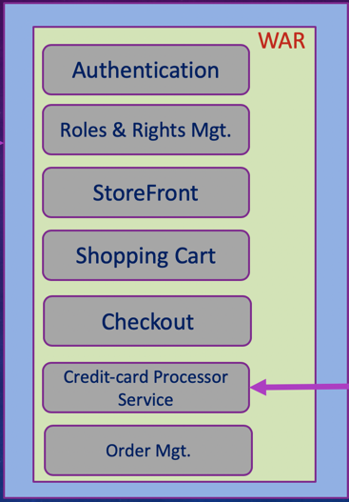
Scaling out A Legacy MONOLITHIC Application
Monolithic
Database
Monolithic
Database

Slide 7
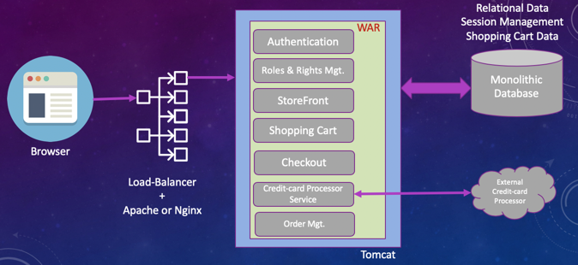
Legacy MONOLITHIC Application Deficiencies
Threads were the bottleneck, this fueled …
Servers with multi-CPUs and …
Introduced the concept of multi-cores
But fundamentally they were suffering from:
Limited Concurrent-Processing
Limited in capacity/clustering using Memcached and other similar disk-persistence technologies
Easy prey to DoS attacks (which proliferated the Load-Balancer market space)
Then came Containers/J2EE/EJBs

Slide 8
Enterprise (J2EE) Application Structure
EJB
Authentication Service
WAR
Relational Data
Session Management
Shopping Cart Data
Authentication
Roles & Rights Mgt.
Access Rights Service
StoreFront
Database
DATA
WAREHOUSING
Shopping Cart
Database
EJB
Checkout
Shopping Cart Service
Credit-card Processor
Service
Access Rights Service
Order Mgt.
.
.
.
Tomcat
J2EE Container
Java is now used extensively on the server-side and led to the growth of the Enterprise
Perl, PHP, Cold Fusion are slowly being replaced!

Slide 9
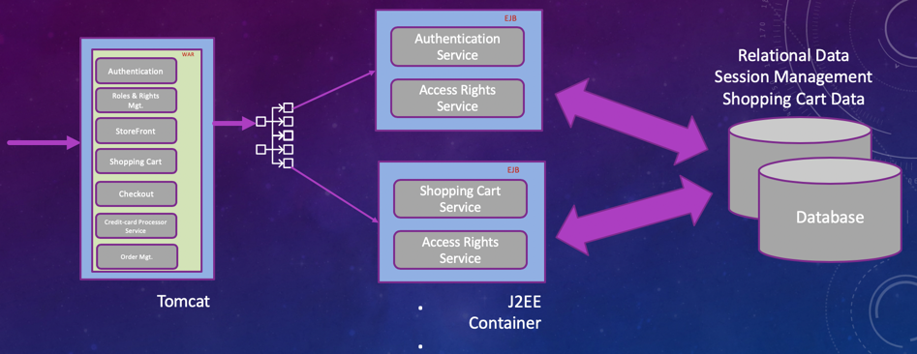
Enterprise (J2EE) Application Deficiencies
Threads were still the bottleneck
But then came multi-cores & multi-CPU’s to push us forward (this meant more POSIX threads)
Reaching 10K concurrent connections was still an issue.
But the underlying problem was shifted to multiple tiers there-by giving the illusion of scaling. But this new architecture gave rise to lookup services/RMI/JNDI
Then came Rod Johnson who introduced the Java world to Spring / DI / IoC… which brought us to the “age of the simple-container”

Slide 10
Age of THE Simple-Container
Session Beans
Entity Beans
JMS
Simple (Web/REST) Container
But in this world how does one SCALE UP?
The World looks back in time
&
Erlang comes to the rescue with Actor-Message
(“little engine that could” from the telecom era)
Welcome to the world of Queues
RabbitMQ, ZeroMQ
MuleSoft
Camel etc.
➔ Enterprise Service Bus [ESB]
Java was the ruler in this domain!
Dependency Injection & Inversion of Control meets modern world
Simplified Software Development & Deployment
In between all of this the web hosting world was shifting to a CLOUD

Slide 11
Birth-Of-THE-Cloud vs The enterprise
Cloud
@ The Enterprise
The generation that was left behind in the web world with PHP, Cold Fusion, Perl got a new boost with the cloud. They began reinventing the old tools in a new paradigm.
Newer easy to deploy, easy to spin off new instances and tool sets such as Python, Ruby began to populate the landscape.
Ruby on Rails, Django for Python, CakePHP for PHP were showing off how easy it is to create applications
To compete with this Java introduces Groovy (and Grails) … this revolution eventually takes us to POLYGOT software development! Scripting language support gets introduced into Java
Data storage solutions increases to support the increased data growth
Map-Reduce comes to the rescue for searching through the forest for a needle.
Distributed File systems takes center-stage introducing Peta Bytes and Yeta Bytes into our everyday vocabulary
Java solves the challenges with Hadoop, HDFS
Exponential growth of data
DATA BECOMES THE KING
To support this new wave, there is a silent revolution going on in the back-drop within the storage world with iSCSI, de-duping, multipath, RAID-10, Fiber-Channel, Infiniband, dNFS, ZeroCopy, etc.

Slide 12
Data meets the Cloud… Event-Loop/kqueue
With better tools and services for easy deployment folks began experimenting with technologies that dominated the browser-side such as:
V8 engine for JavaScript leveraging the event-loop
Services like Heroku, Digital Ocean began to take over.
World of Cloud Applications and scripting languages like Python, Ruby, Closure began to proliferate
To complete with that Java secret weapon:
Spring Boot > Micronaut
GraalVM (more on this in the next slides)
Everyone can own a piece of the pie and the BIG DREAM
Spinning new instances for scaling up and down became the norm
This laid the perfect breading ground for …
MICROSERVICES
Small loosely coupled, highly maintainable, independently deployable pieces of components that makes up a BIG application
Node JS and similar languages solved the 10K problem but then inherited limitations within the run-time engine and context switching!

Slide 13
Throughout this journey there has always been a need for a common set of core principles and services to make this technology evolution possible
The Common thread
Configuration Management
Service Discovery & Lookup
Load Balancing
API Gateway (service gateway)
Security
Logging > (centralized logging)
Application Tracing (distributed tracing)
Debugging
Fault-Tolerance (Resilience)
Packaging, Deployment, Scheduling
Job Management
The very same concerns that existed since the microbial/mainframe days still exist today in microservices but how we solve them in the world of microservices is evolving!
How we leverage this trend and use it to our needs defines our prosperity!

Slide 14
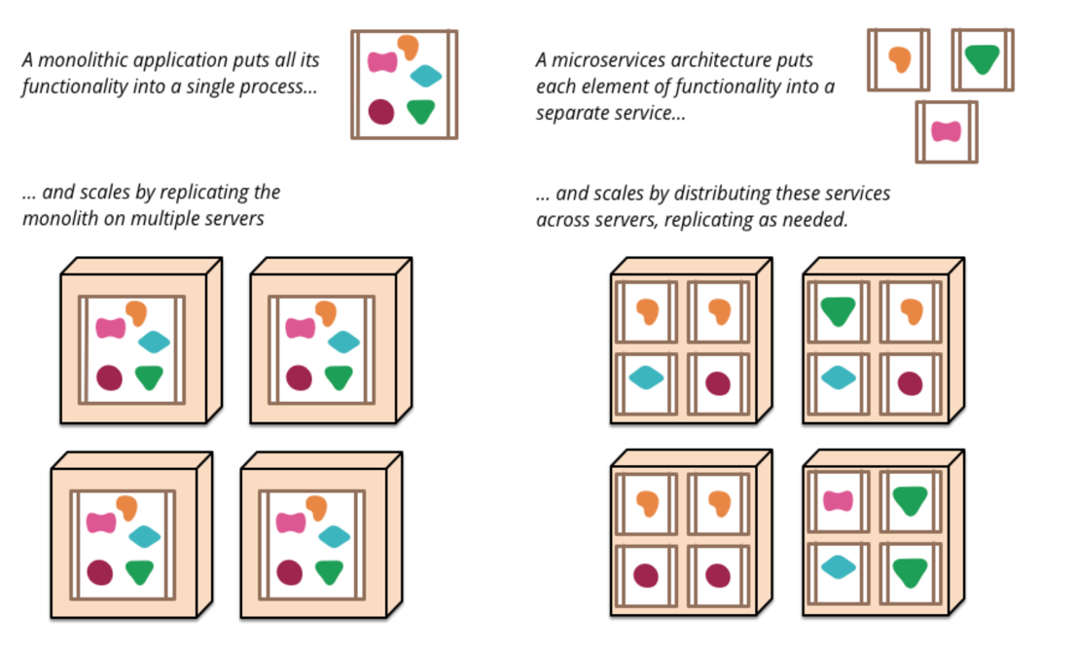
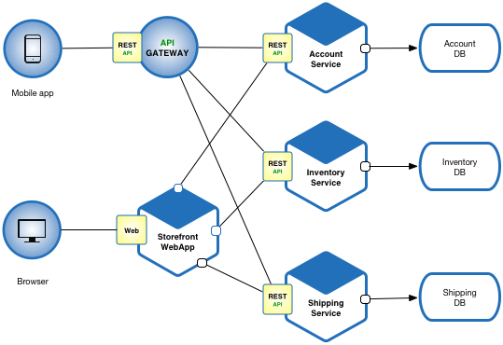
Microservices at 30,000 feet
https://martinfowler.com/articles/microservices.html
https://microservices.io/

Slide 15
MICROSERVICES – The CURRENT TREND
Configuration Management ……............................... Spring Config
Service Discovery & Lookup ……………………………….... Netflix Eureka/etcd/Consul/ZooKeeper
Load Balancing … Nginx / F5 BIG IP/ Netflix Ribbon / Riot Games / AWS Route 53 / RedBird
API Gateway (service gateway) ……….. Application Specific (REST API) – Tyk, Kong, Gravitee
Security ………….. Application Specific Dominance (Spring Cloud Zuul)
Logging > (centralized logging) ………. ELK Stack / Splunk
Application Tracing (distributed tracing) ….. Spring Spectator & Atlas / Grafana | Zipkin | Jaeger
Debugging …… GrayLog, ELK, Splunk
Fault-Tolerance (Resilience) …… Spring Hystrix, Turbine, Ribbon , Kong, Resilience4j
Packaging ……….. Native to language, Java > Maven, Node > npm, etc.
Deployment ………………. container-specific, cloud-specific
Scheduling …… Kafka, Walmart Labs BigBen, Celery Job queue, Risque for Ruby
Job Management ….. SLURM, Torque, PBS Pro, Open Lava
Authentication ……… Kong/OAUTH/JWT

Slide 16
Evolving Tool CHAINS Example
Service Discovery & Registry: Netflix Eureka → ??? (Netflix has discontinued development – hence the proliferation of new services)
Deployment: Netflix Asgard (deprecated) → Spinnaker (red/black | blue/green deployments)
With so many tools to learn – which basket should I put my eggs?
Focus on learning the patterns that serve the Microservices architecture rather than a specific framework
Let the technology-leads at large-organizations cherry-pick the grandiose pieces
Since we are a Java-shop, learn Spring-Boot, Micronaut and GraalVM
By the time the dust settles on the Java front wrt microservices, it will be a totally different landscape from where we are today. So understanding them at a high-level is key (not the details – we are focusing on the broad strokes and not the finer details)
Focus on a much simpler model (ZeroConfig) where a lot of the ground-work has been simplified for you such as Node.js/JavaScript based Microservices frameworks like Molecular or Cote (this will help you get a better understanding of the parts and how they are evolving)

Slide 17
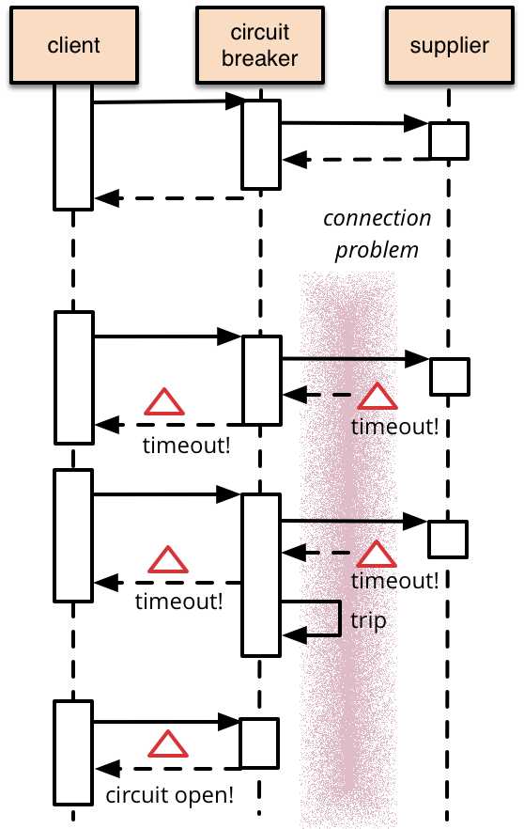
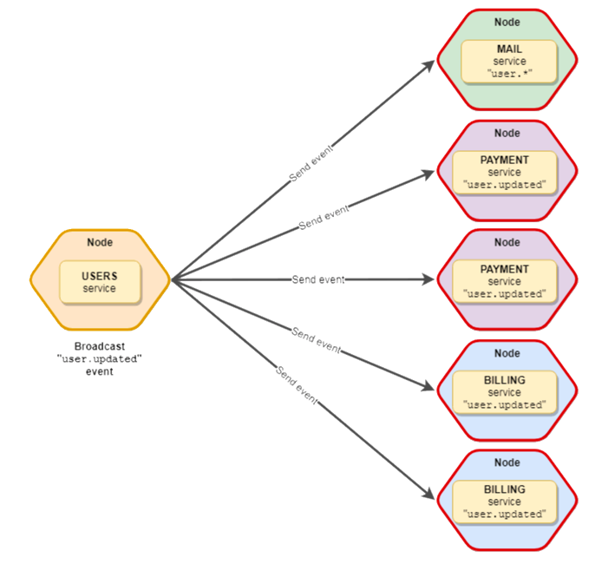
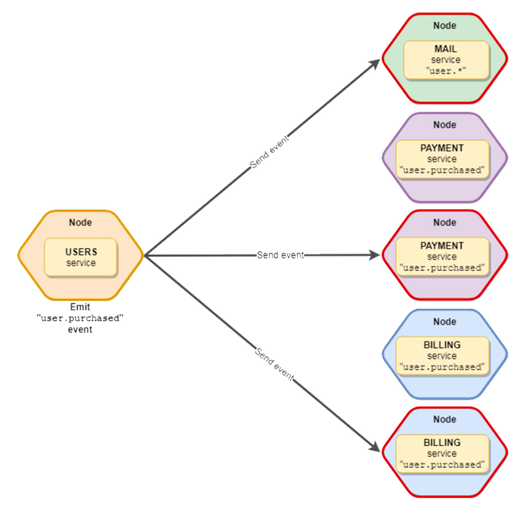
Common microservices Patterns
Circuit-Breaker pattern
Rate-Limiter pattern
Bulkhead (limit amount of parallel executions)
Retry
Cache
Time Limit
Health
{Balanced, Broadcast} Events

Slide 18
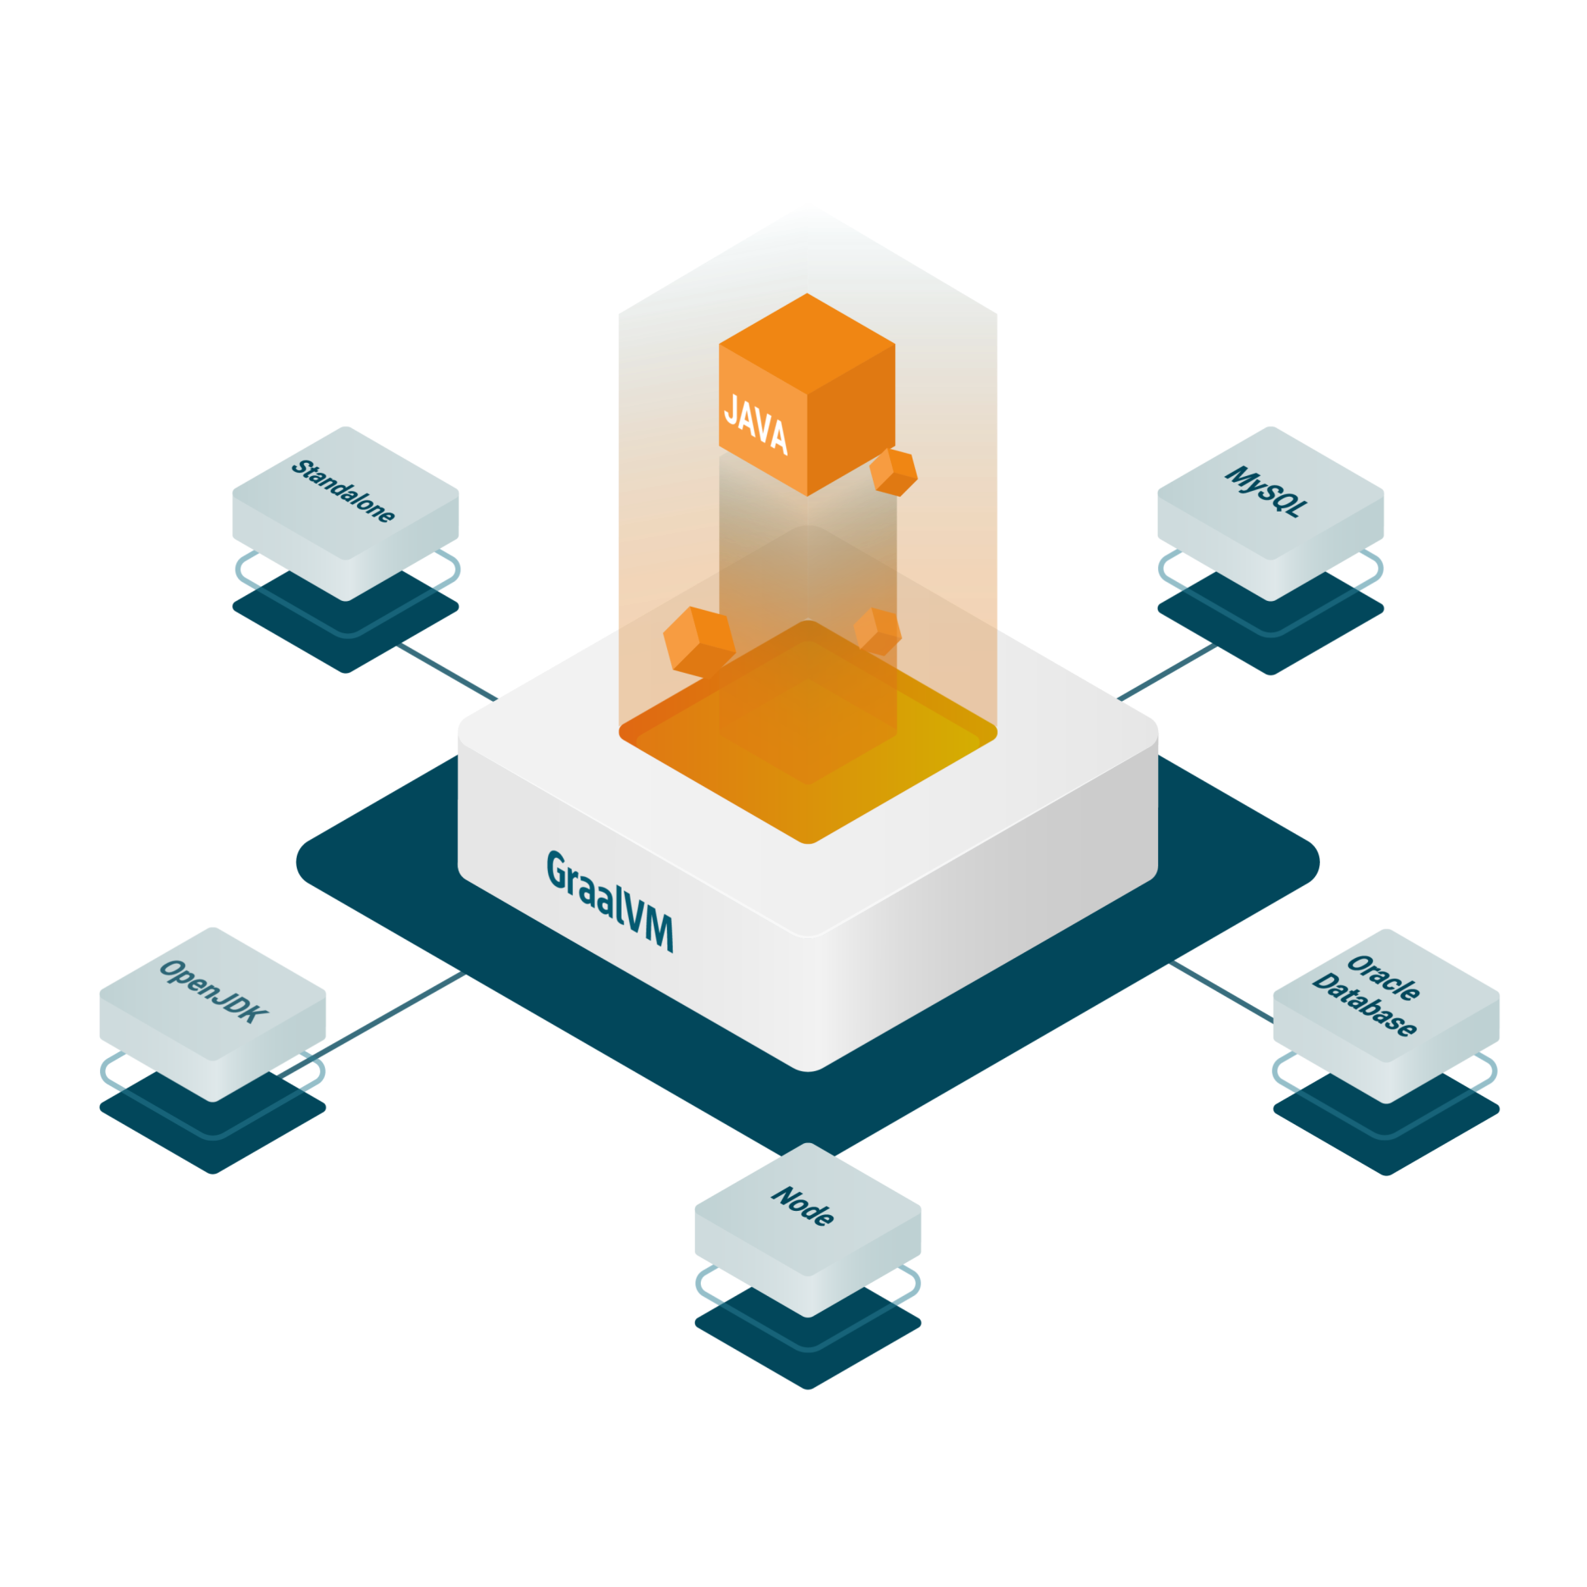
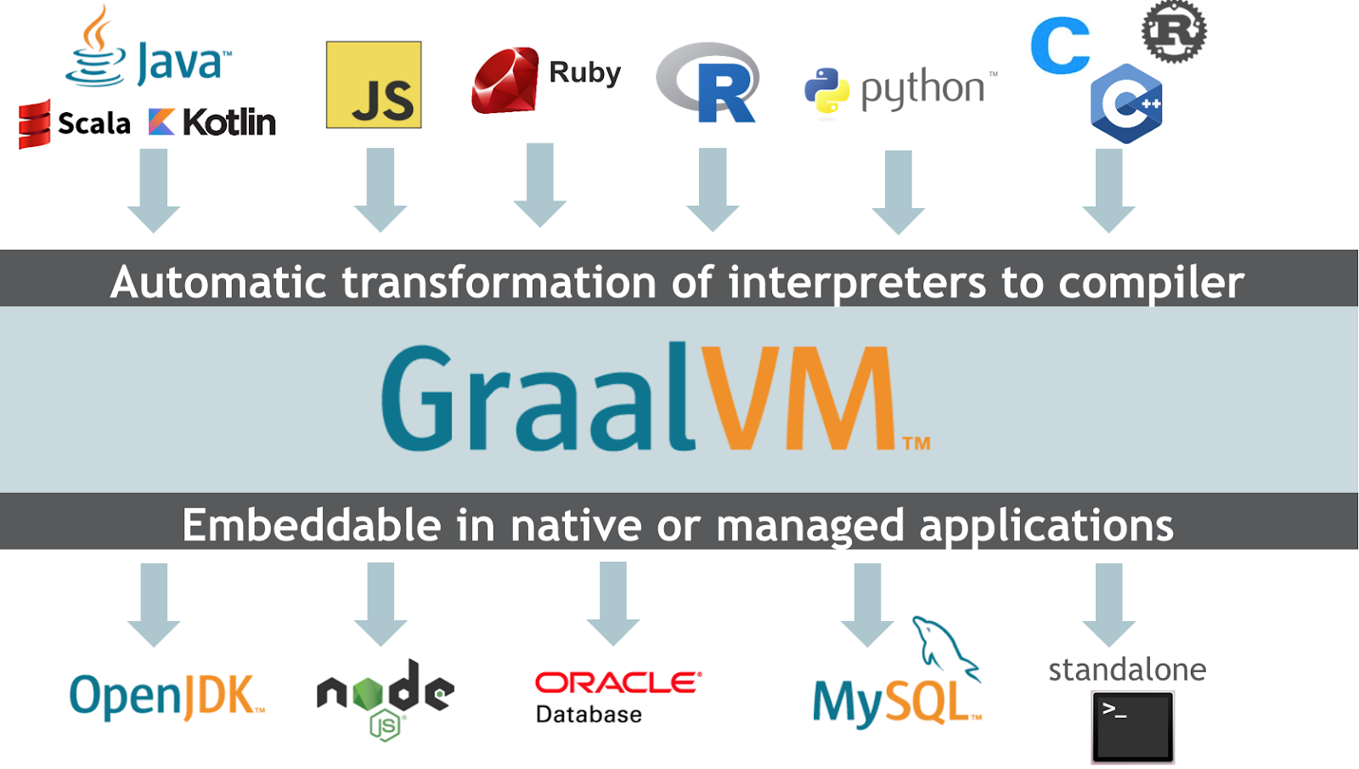
Java GRAALVM – future DEFINED
GraalVM is a universal virtual machine for running applications written in JavaScript, Python, Ruby, R, JVM-based languages like Java, Scala, Kotlin, Clojure, and LLVM-based languages such as C and C++.
GraalVM removes the isolation between programming languages and enables interoperability in a shared runtime. It can run either standalone or in the context of OpenJDK, Node.js, Oracle Database, or MySQL.
Run Programs Faster Anywhere

Slide 19
Javascript – Node.js – Cote.JS
JavaScript / Node.js Based
http://cote.js.org/
https://moleculer.services/
Java-Based
https://micronaut.io/
Recommended Learning Path:
Cote.js
Molecular.js
Spring Boot
Micronaut with Spring Config (server)
Eureka | Consol | ETCD
Understand Micronaut with Eureka
Zipkin
Jaeger
Tyk
Kong
Demo Time
Cote.js - http://cote.js.org - Javascript engineered for microservices

Slide 20
Demo
{welcome}
/index.html
website
server
welcome
component
welcome
component
/welcome
welcome
component
welcome
component
https://bitbucket.org/vguhesan/understanding-microservices-demo/
git clone https://vguhesan@bitbucket.org/vguhesan/understanding-microservices-demo.git

Slide 21
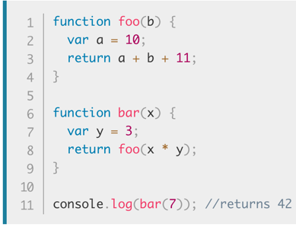
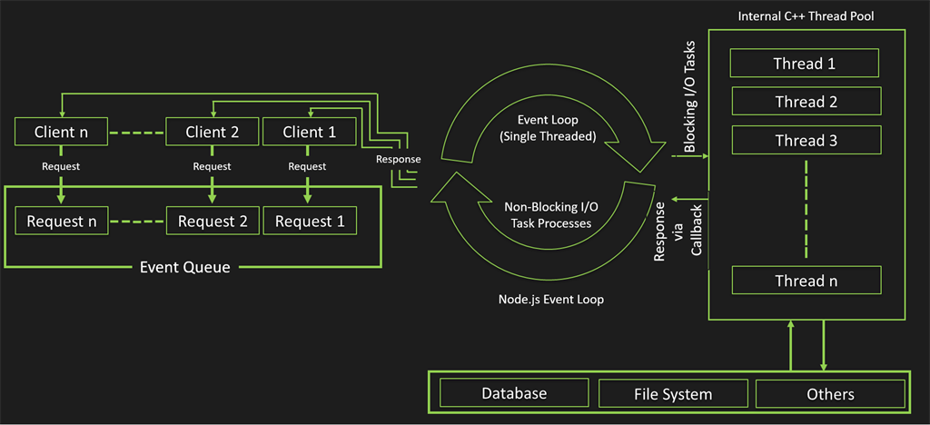
Node.js Misunderstood
How does node.js scale using the event loop?
Shared resources include:
CPU
Network
Network interfaces
Memory
Disk
Stack
Heap
foo() {…}
bar() {…}

Slide 22


It’s Time to leave your own footprints with microservices

